Slide 1
PWA workshop
Part 4
Web Push Notifications
Notes:
https://the-guide.github.io/fe-guild-2019-pwa-code-labs/

Slide 2
Web Push Notifications

Slide 3
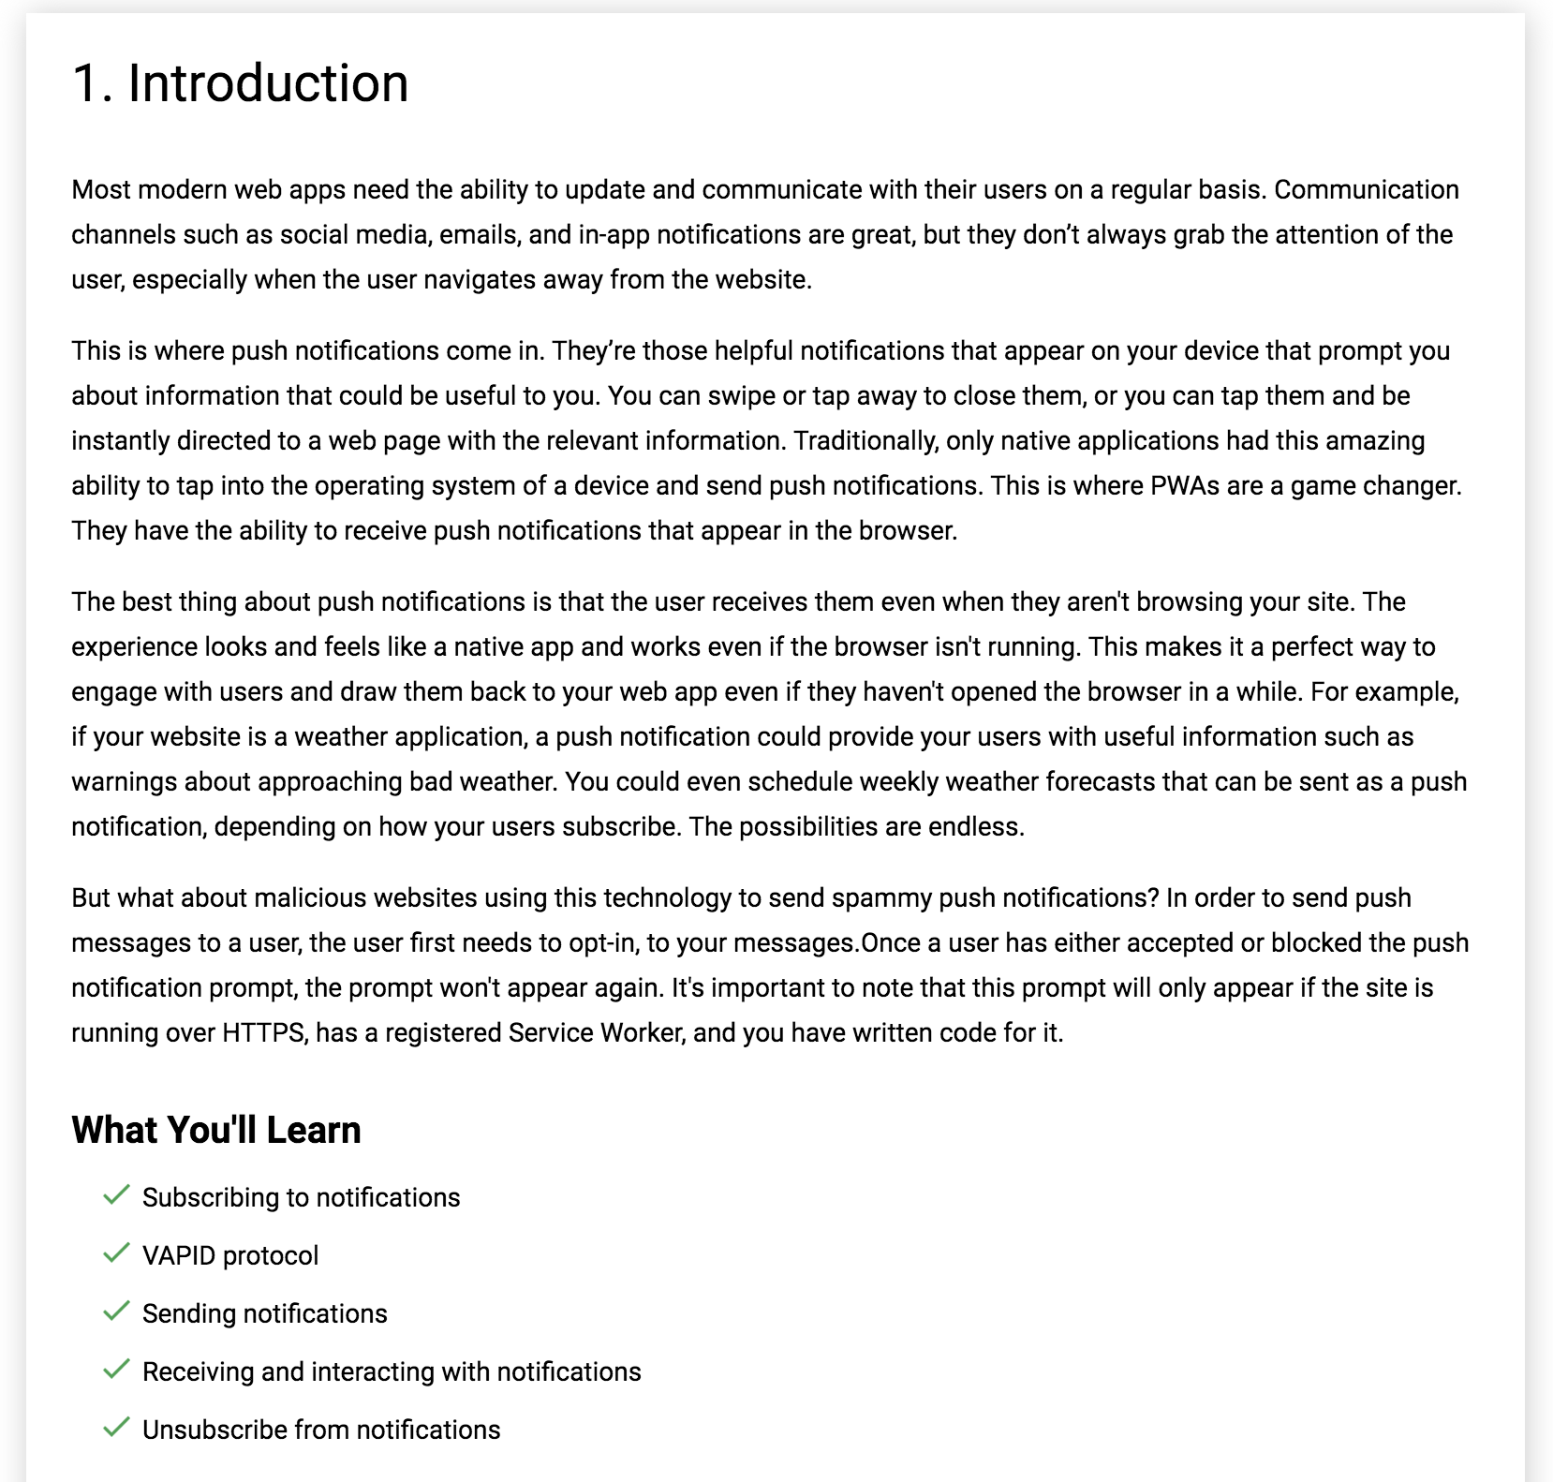

Slide 4
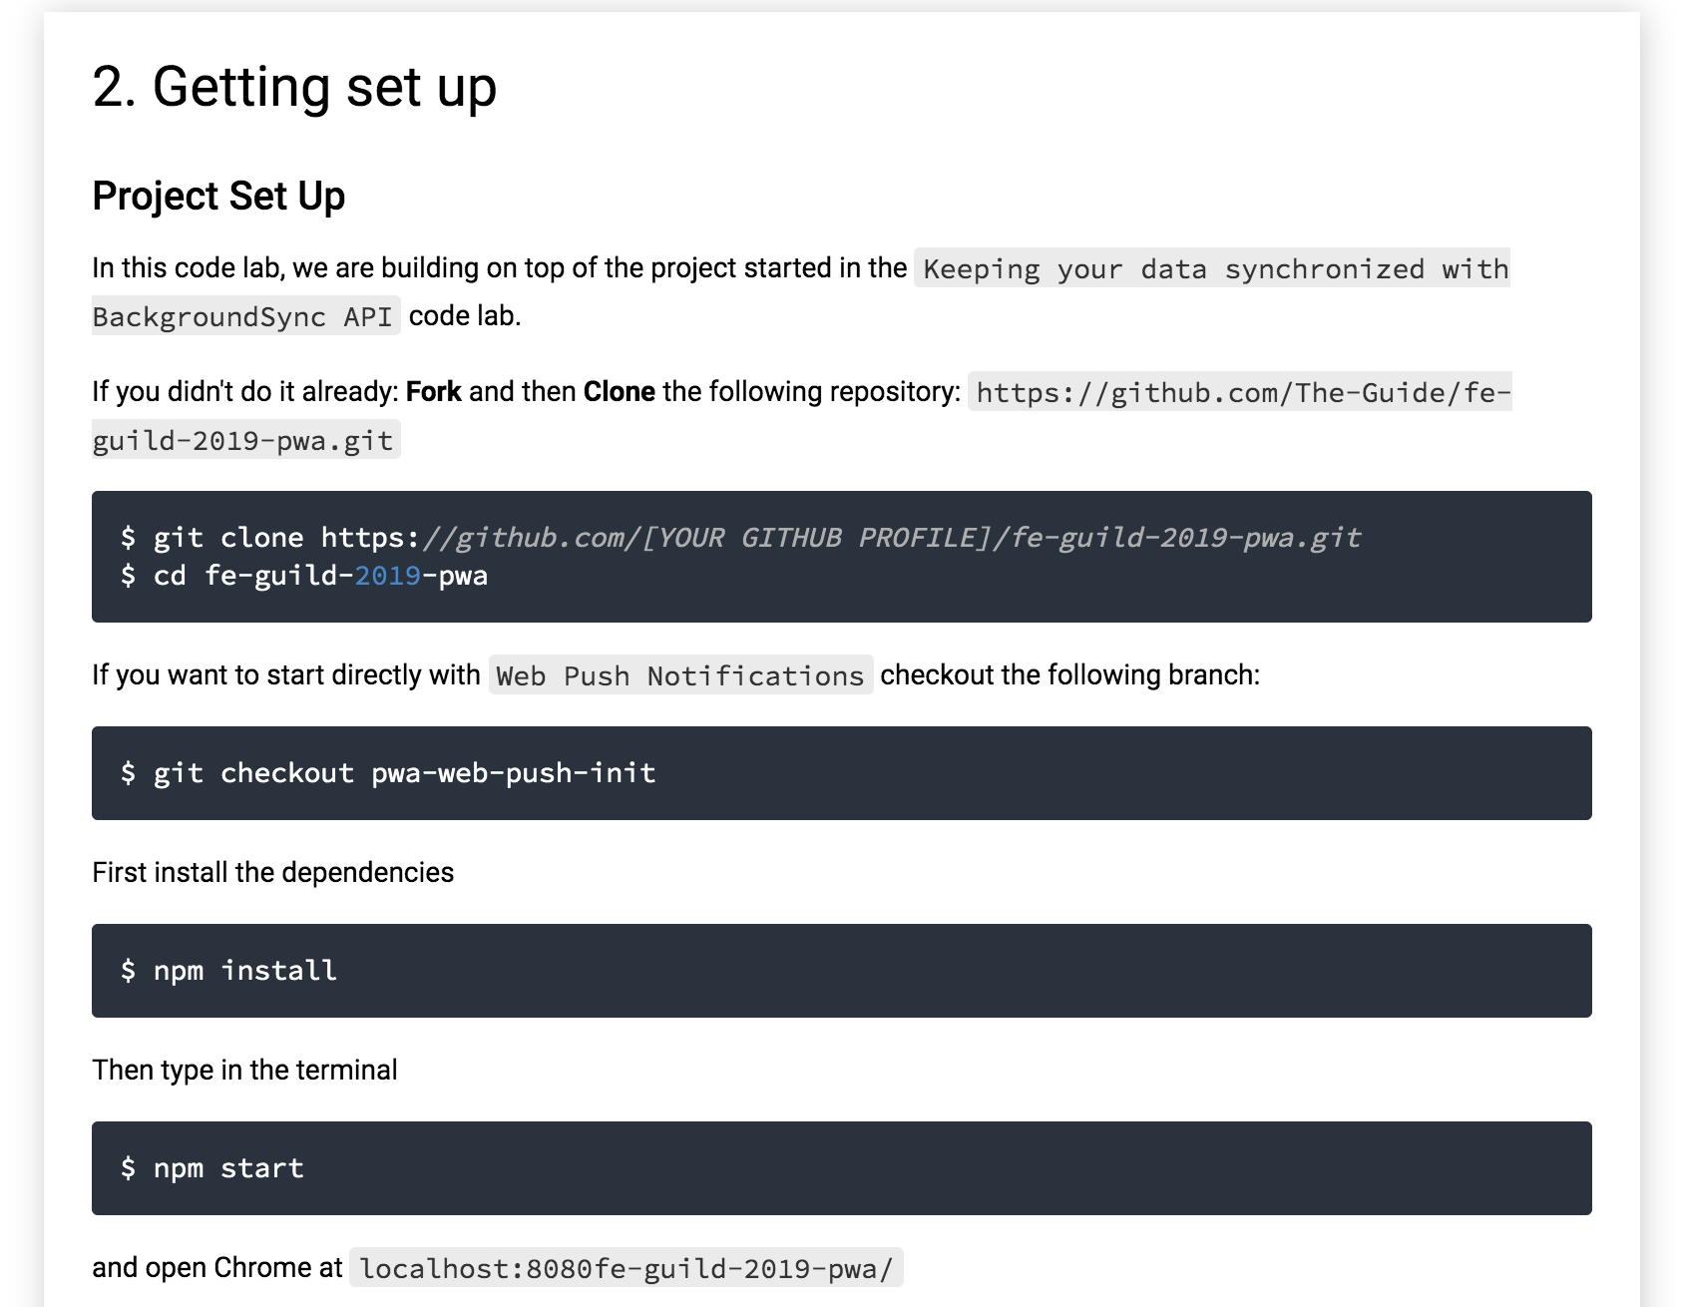

Slide 5
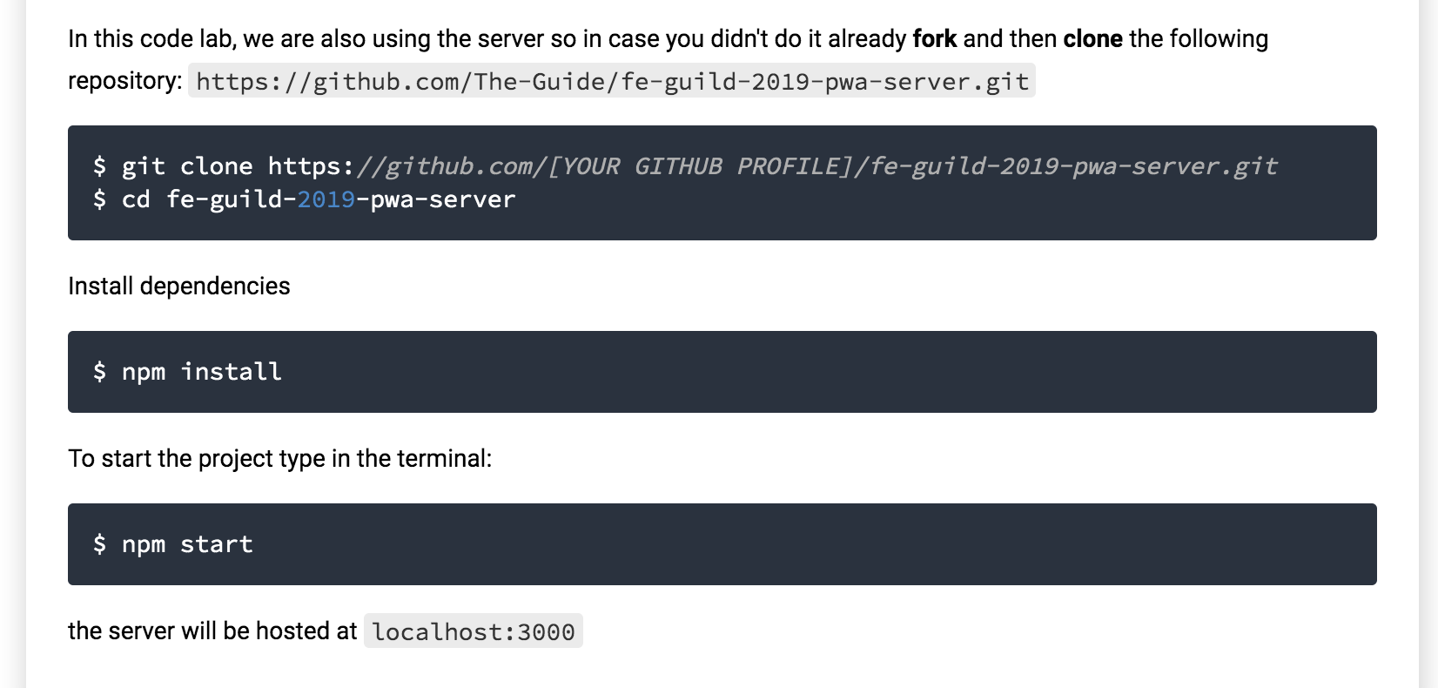

Slide 6
3. User permissions
The browser displays a prompt asking a user if they'd like to opt-in to notifications. If they accept, you can save their subscription details on the server and use them to send notifications later. These subscription details are unique to each user, device, and browser, so if a user logs in to your site on multiple devices, they'll be prompted once per device.
Once they've accepted, you can use these stored subscription details to send messages to a user later with a scheduled task that updates users with timely information.
Before you can start sending notifications to a user, you need to ask their permission by displaying a prompt. This prompt functionality is built into the browser by default, but first, you need to add a little code to ensure that this prompt is initiated. If a user accepts the prompt, you'll be provided with a subscription object containing information about their subscription. But if a user denies the prompt, you won't be able to send them any messages, and they won't be prompted again. This ensures that you aren't able to annoyingly prompt users every time they visit your site.

Slide 7
User permissions in app.js
const enableNotificationsButtons = document.querySelectorAll('.enable-notifications');
const askForNotificationPermission = () => {
Notification.requestPermission(result=> {
console.log('User Choice', result);
if (result !== 'granted') {
console.log('No notification permission granted!');
} else {
console.log('Notification permission granted!');
}
});
};
if ('Notification' in window) {
for (let i = 0; i < enableNotificationsButtons.length; i++) {
enableNotificationsButtons[i].style.display = 'inline-block';
enableNotificationsButtons[i].addEventListener('click', askForNotificationPermission);
}
}

Slide 8
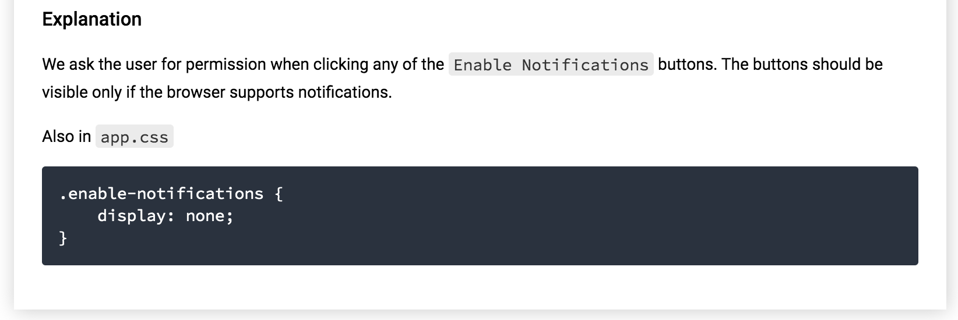

Slide 9
4. Displaying a Notification to the User in App.js
const displayConfirmNotification = () => {
const options = {
body: 'You successfully subscribed to our Notification service!'
};
new Notification('Successfully subscribed!', options);
};
const askForNotificationPermission = () => {
Notification.requestPermission(result=> {
console.log('User Choice', result);
if (result !== 'granted') {
console.log('No notification permission granted!');
} else {
displayConfirmNotification();
}
});
};

Slide 10
Notifications options: Notifications can be sent from the Service Worker registration and can receive an options object that can control both the visual and behavioral aspect of the notification.
const displayConfirmNotification = () => {
if ('serviceWorker' in navigator) {
const options = {
body: 'You successfully subscribed to our Notification service!',
icon: 'src/images/icons/app-icon-96x96.png',
image: 'src/images/main-image-sm.jpg',
dir: 'ltr',
lang: 'en-US', // BCP 47,
vibrate: [100, 50, 200],
badge: 'src/images/icons/app-icon-96x96.png'
};
navigator.serviceWorker.ready
.then(sw => sw.showNotification('Successfully subscribed (from SW)!', options));
}
};

Slide 11
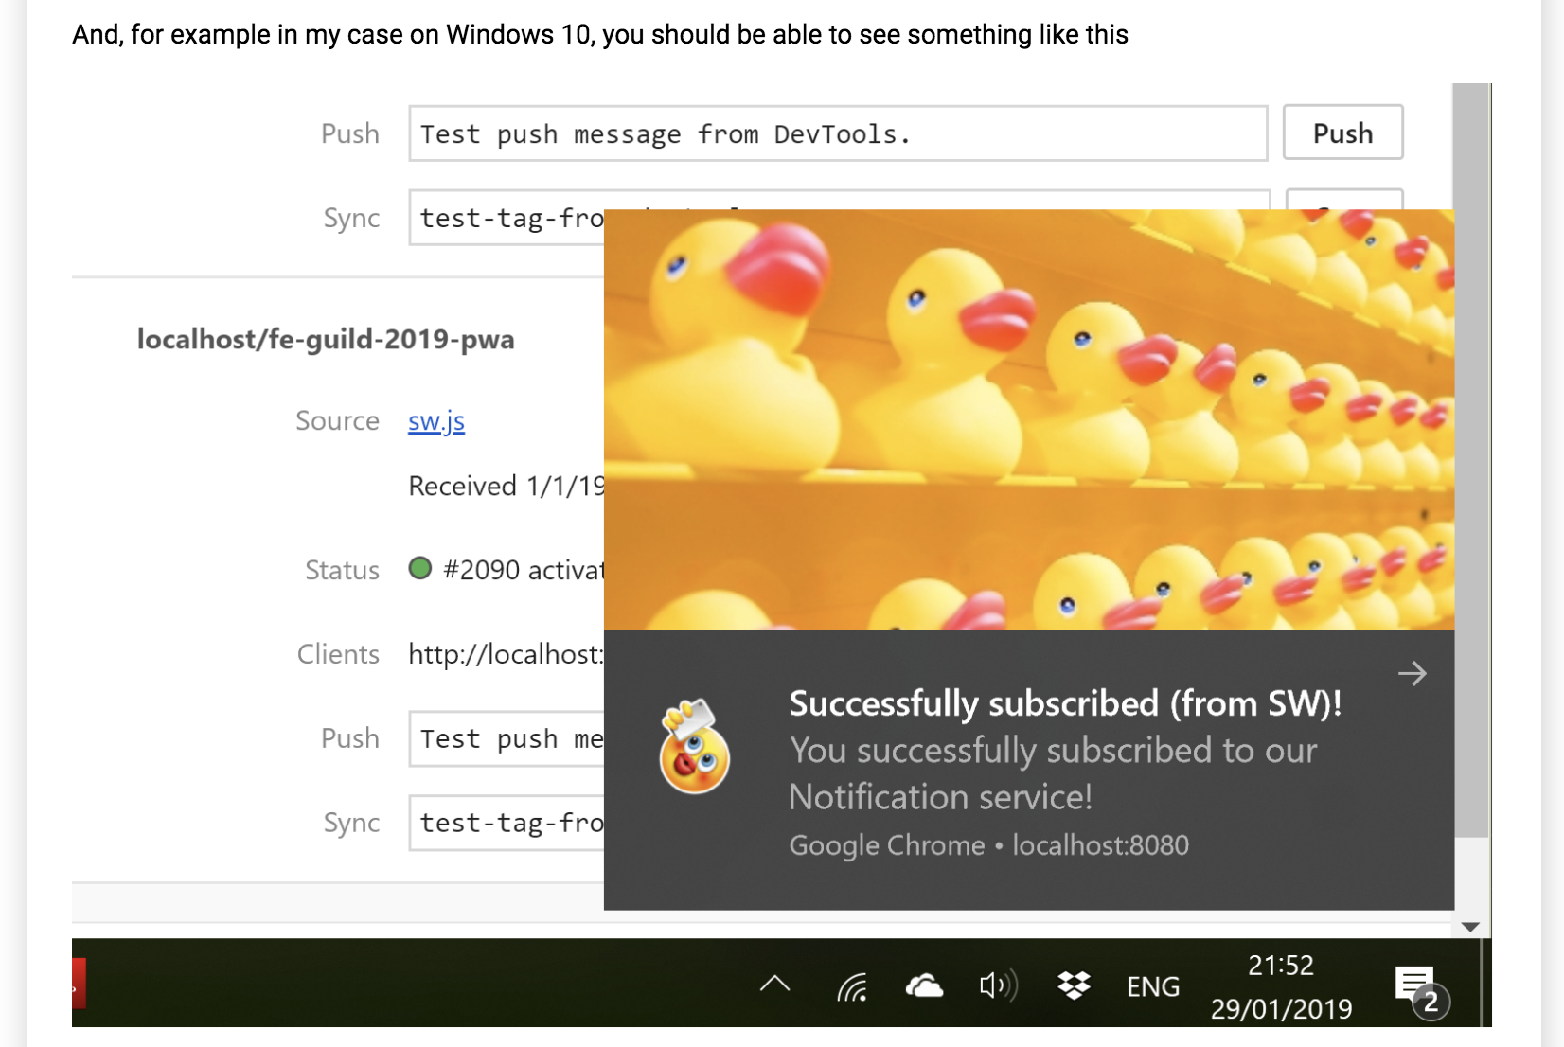

Slide 12
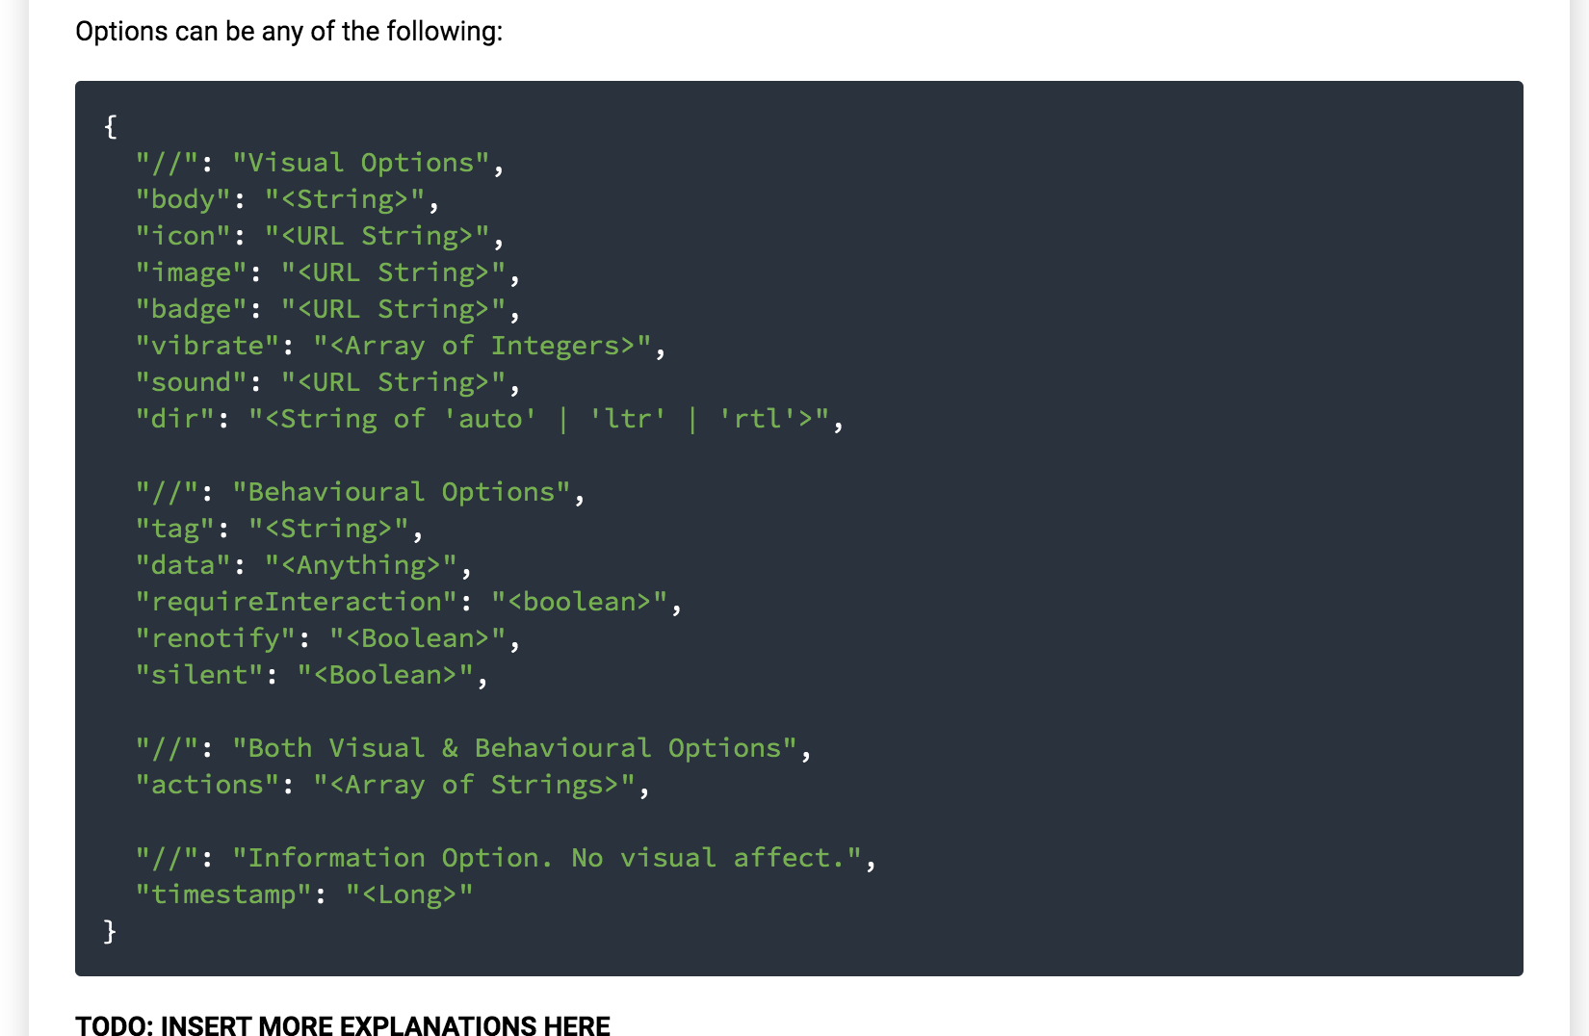

Slide 13
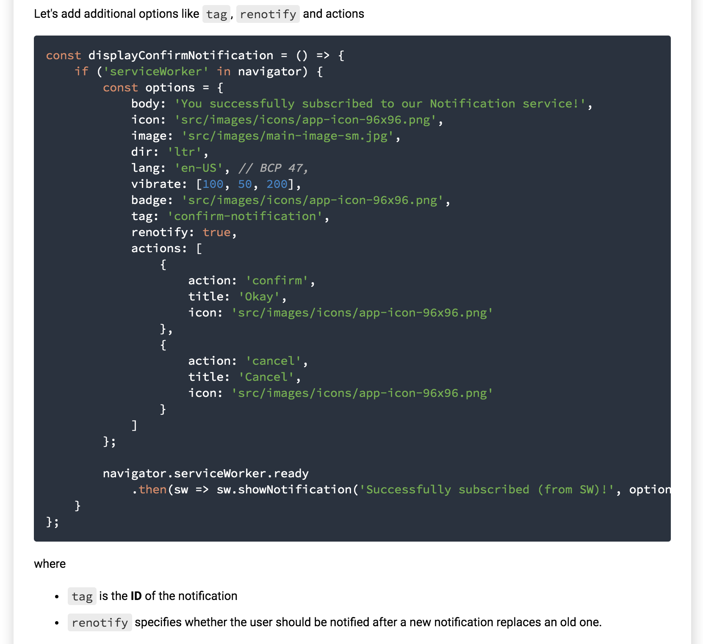

Slide 14
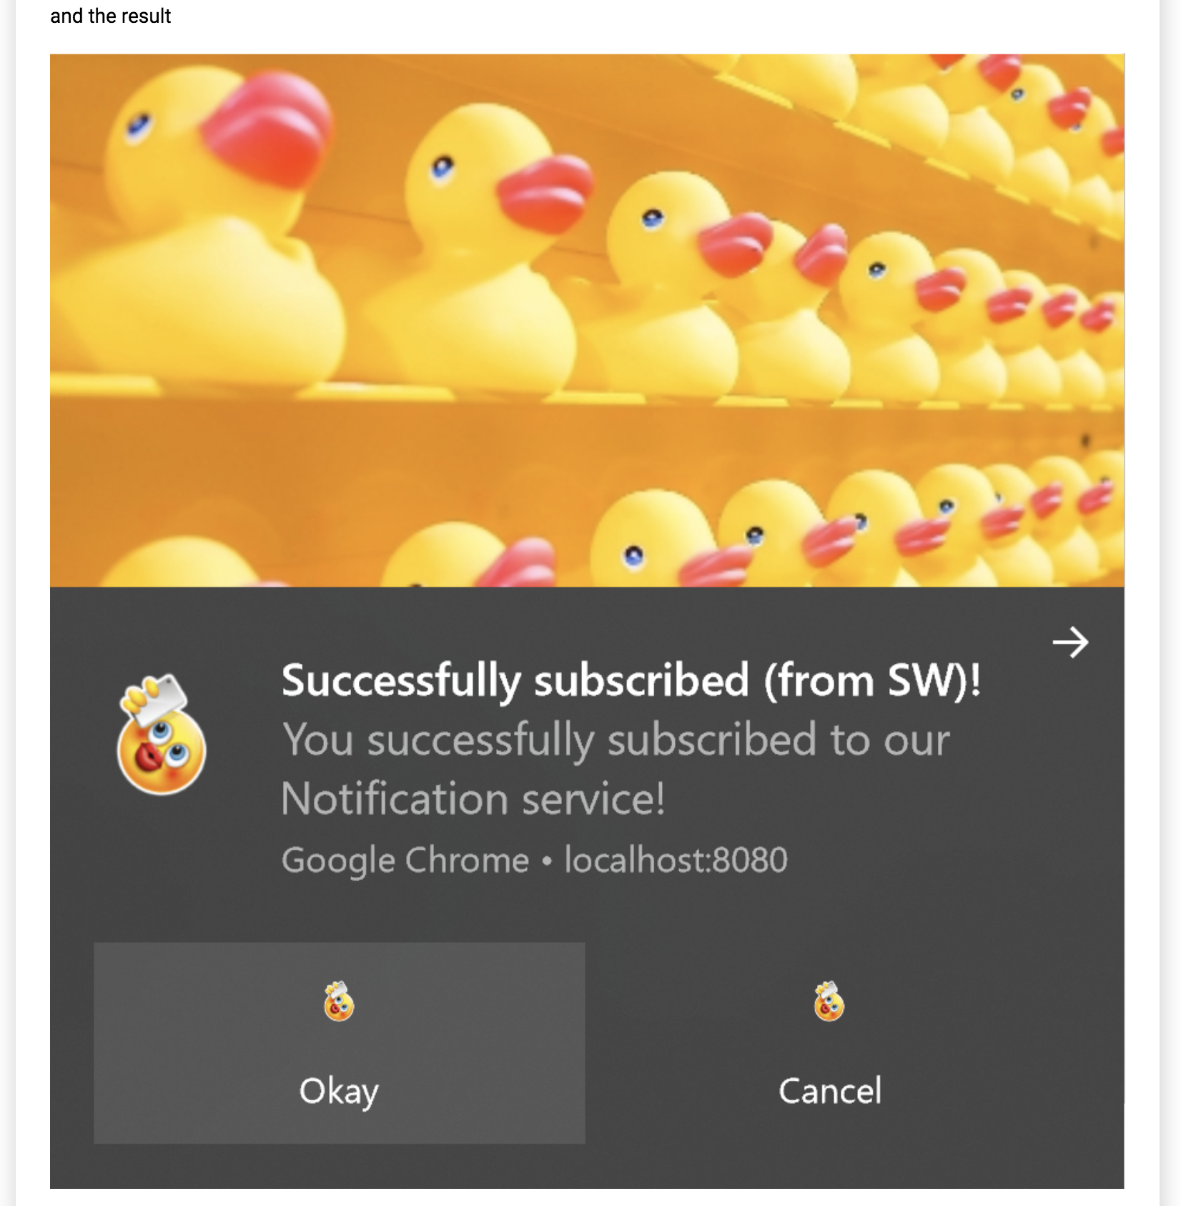

Slide 15
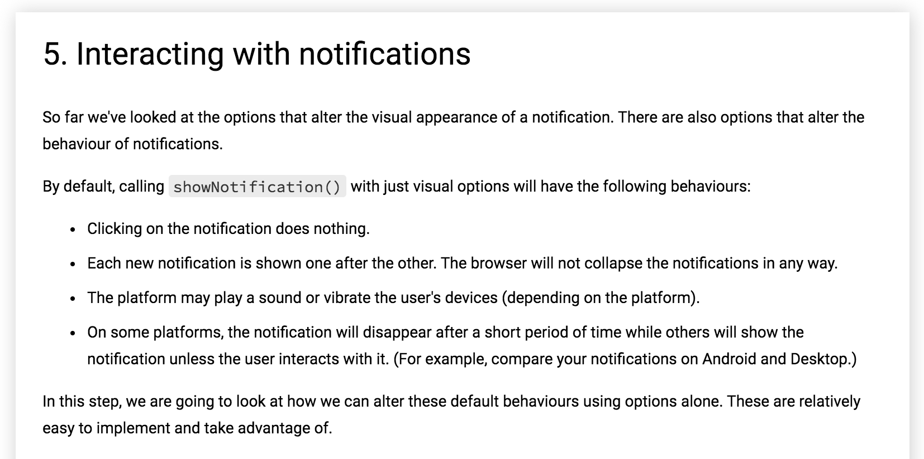

Slide 16
Notification Click Event
When a user clicks on a notification, the default behaviour is for nothing to happen. It doesn't even close or removes the notification.
The common practice for a notification click is for it to close and perform some other logic (i.e., open a window or make some API call to the application).
To achieve this, we need to add a notificationclick event listener to our service worker. This will be called whenever a notification is clicked.

Slide 17
In sw-template.js:
self.addEventListener('notificationclick', event => {
const notification = event.notification;
const action = event.action;
console.log(notification);
if (action === 'confirm') {
console.log('Confirm was chosen');
notification.close();
} else {
console.log(action);
notification.close();
}
});
self.addEventListener('notificationclose', event => console.log('Notification was closed', event));

Slide 18
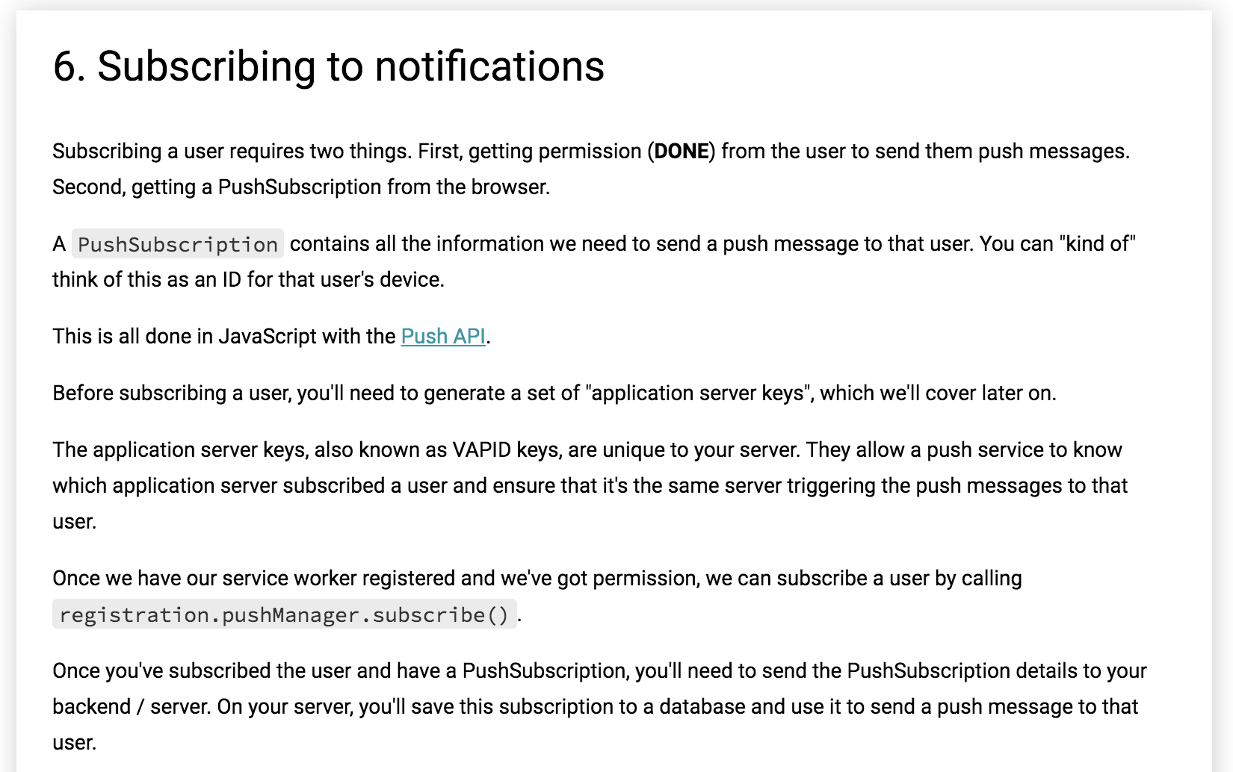


Slide 19
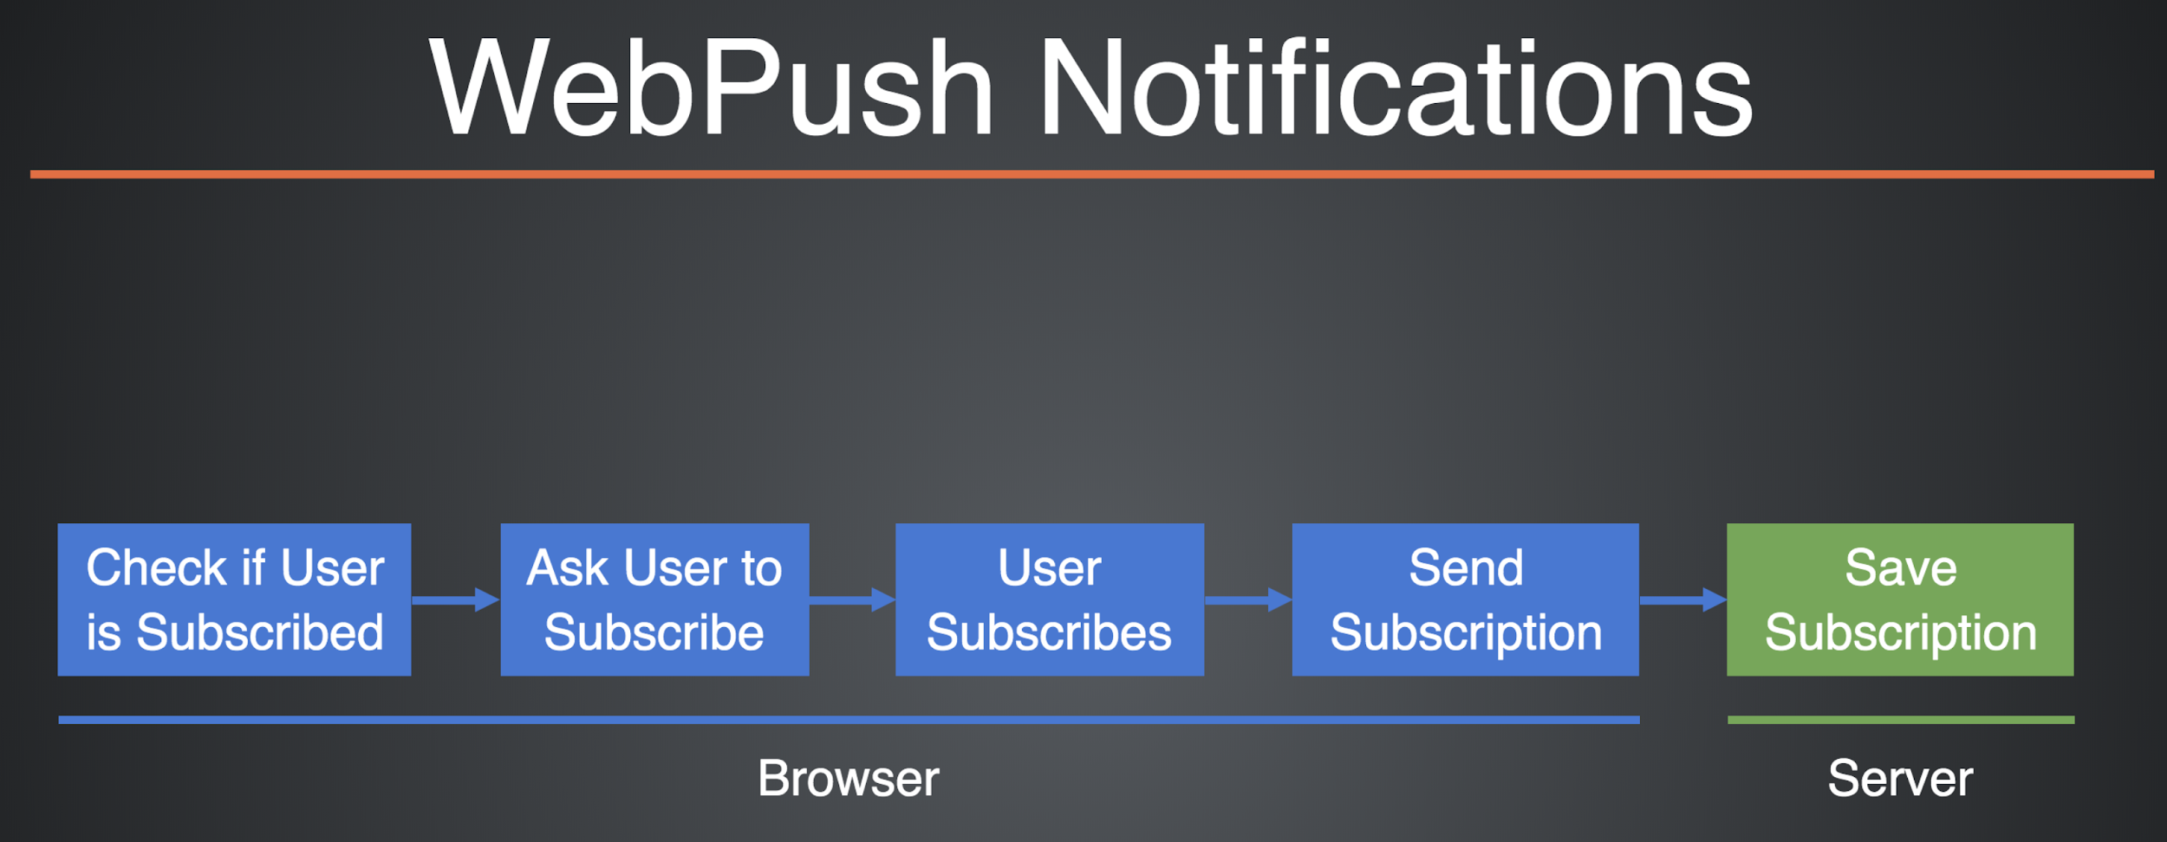

Slide 20
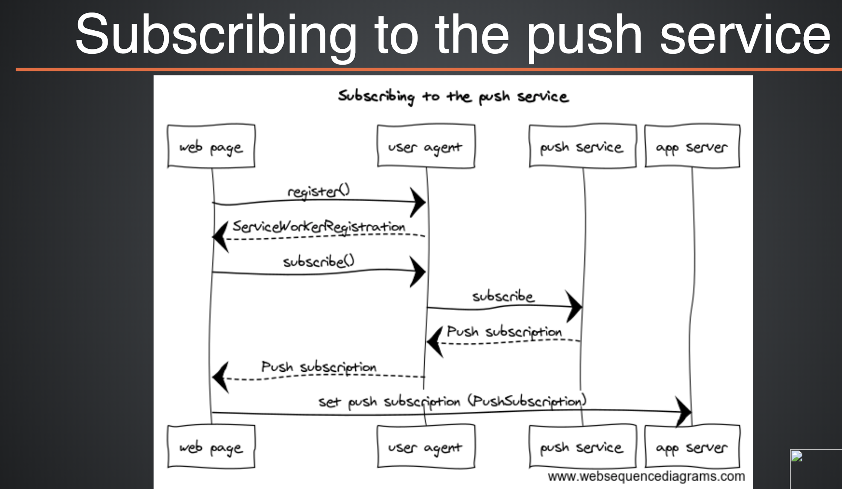

Slide 21
In app.js just above askForNotificationPermission:
const configurePushSubscription = () => {
if ('serviceWorker' in navigator) {
let serviceWorkerRegistration;
navigator.serviceWorker.ready
.then(registration => {
serviceWorkerRegistration = registration;
return registration.pushManager.getSubscription();
})
.then(subscription => {
if (subscription === null) { // Create a new subscription
return serviceWorkerRegistration.pushManager.subscribe({
userVisibleOnly: true,
applicationServerKey: urlBase64ToUint8Array('PUBLIC KEY HERE')
});
})
.then(pushSubscription => {
console.log('Received PushSubscription: ', JSON.stringify(pushSubscription));
return pushSubscription;
});
}
};

Slide 22
In utility.js
const urlBase64ToUint8Array = base64String => {
const padding = '='.repeat((4 - base64String.length % 4) % 4);
const base64 = (base64String + padding)
.replace(/-/g, '+')
.replace(/_/g, '/');
const rawData = window.atob(base64);
const outputArray = new Uint8Array(rawData.length);
for (let i = 0; i < rawData.length; ++i) {
outputArray[i] = rawData.charCodeAt(i);
}
return outputArray;
};

Slide 23
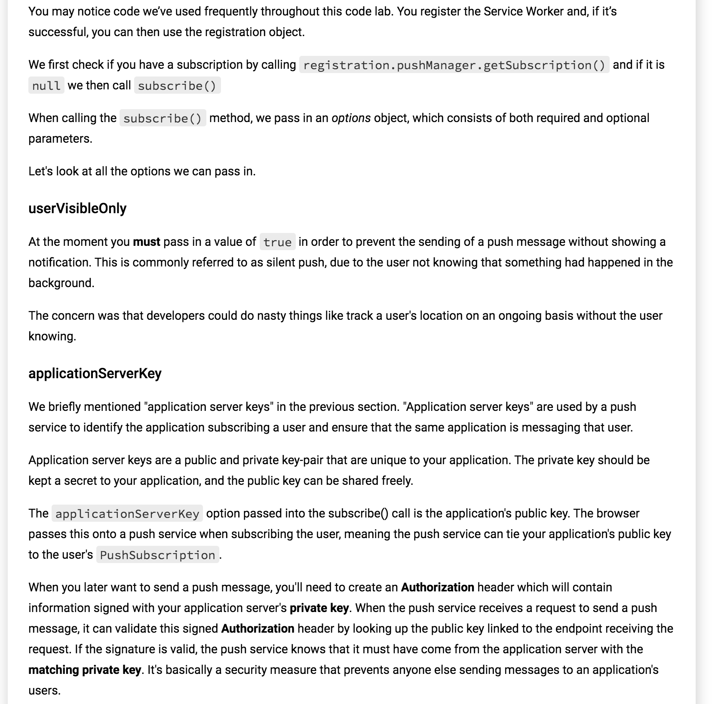

Slide 24
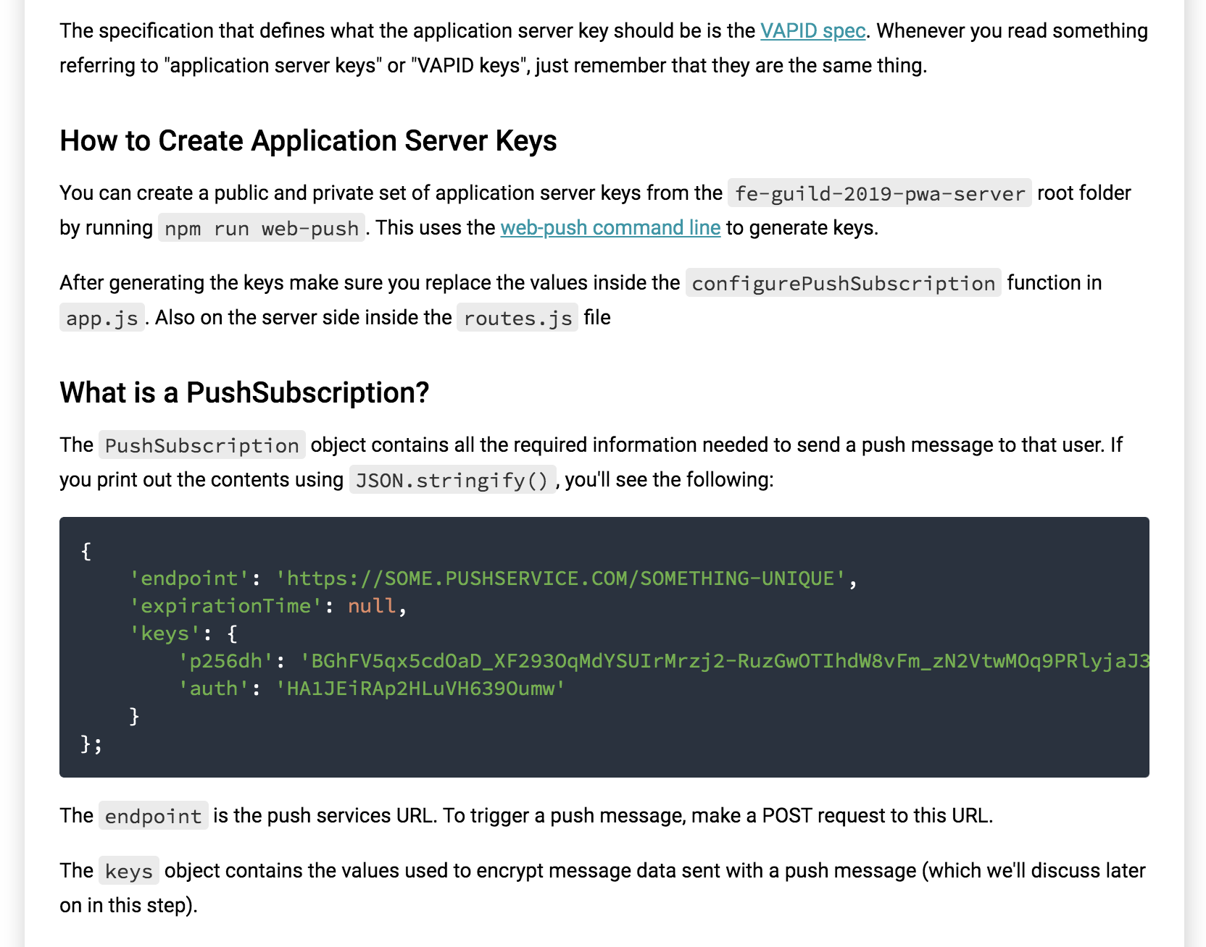

Slide 25
Send a Subscription to the Server
Once you have a push subscription, you'll want to send it to your server. It's up to you how you do that, but a tiny tip is to use JSON.stringify() to get all the necessary data out of the subscription object.
Adapt the configurePushSubscription function in app.js
const configurePushSubscription = () => {
if ('serviceWorker' in navigator) {
let serviceWorkerRegistration;
navigator.serviceWorker.ready
.then(registration => {
serviceWorkerRegistration = registration;
return registration.pushManager.getSubscription();
})
.then(subscription => {
if (subscription === null) {
// Create a new subscription
return serviceWorkerRegistration.pushManager.subscribe({
userVisibleOnly: true,
applicationServerKey: urlBase64ToUint8Array('PUBLIC KEY HERE')
});
}
};

Slide 26
next:
})
.then(pushSubscription => {
return fetch(`${SERVER_URL}/subscriptions`, {
method: 'POST',
headers: {
'Content-Type': 'application/json',
'Accept': 'application/json'
},
body: JSON.stringify(pushSubscription)
});
})
.then(response => {
if (response.ok) {
displayConfirmNotification();
}
})
.catch(error => console.log(error));
}

Slide 27
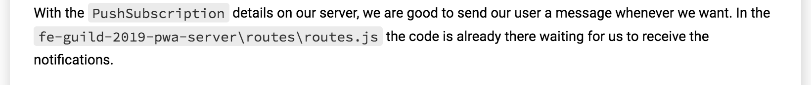

Slide 28
7. Receiving notifications
Now that we've stored the user's unique subscription details, we can start sending push messages to them and provide them with timely updates on important notifications.
On the front-end code, we need to add some code to our Service Worker. The code in the next listing shows how to listen for the push event and display a push notification accordingly.

Slide 29
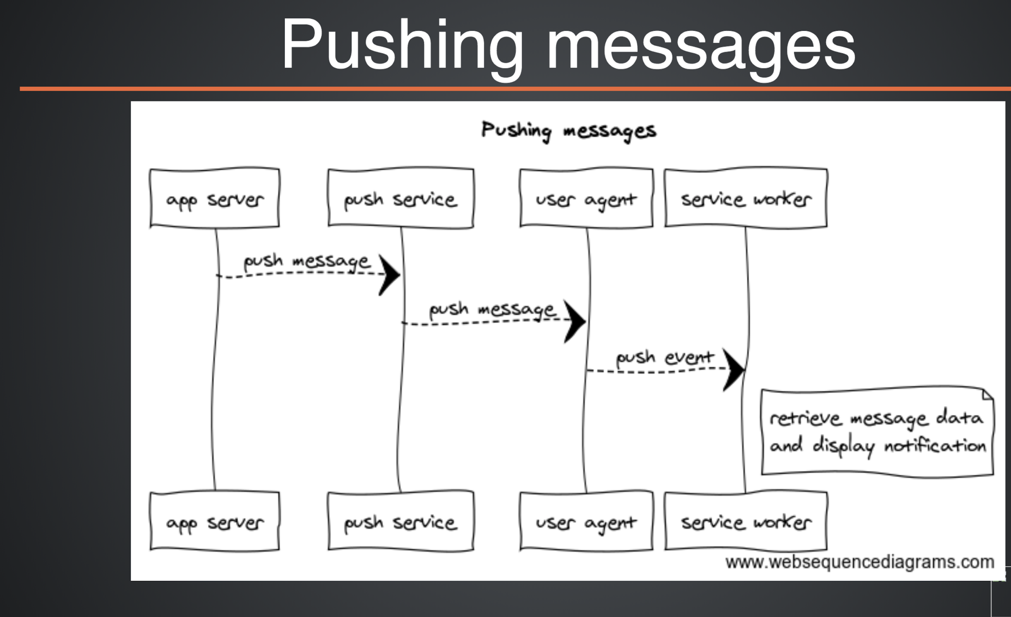

Slide 30
In sw-template.js
self.addEventListener('push', event => {
console.log('Push Notification received', event);
let data = {title: 'New!', content: 'Something new happened!', openUrl: '/'};
if (event.data) {
data = JSON.parse(event.data.text());
}
const options = {
body: data.content,
image: data.imageUrl,
icon: 'src/images/icons/app-icon-96x96.png',
badge: 'src/images/icons/app-icon-96x96.png',
data: {
url: data.openUrl
}
};
event.waitUntil(
self.registration.showNotification(data.title, options)
);
});

Slide 31
The code in the listing above listens to the push event and reads the payload of the data sent from the server. With this payload data, you can then display a notification using the showNotification function.
And it looks like this
Hooray! We've sent our first web push notification. You should now notice this appear in the browser. But there's one more step. For the user to interact with the push notification, we need to handle the click event of the notification. We already do that in the notificationclick, but the event handler needs a little update.

Slide 32
In sw-template.js replace the notificationclick event handler:
self.addEventListener('notificationclick', event => {
const notification = event.notification;
const action = event.action;
console.log(notification);
if (action === 'confirm') {
console.log('Confirm was chosen');
notification.close();
} else {
event.waitUntil(
self.clients.matchAll()
.then(clients => {
let visibleClient = clients.find(client => client.visibilityState === 'visible');
if (visibleClient && 'navigate' in visibleClient) {
visibleClient.navigate(notification.data.url);
visibleClient.focus();
}

Slide 33
Next:
else {
self.clients.openWindow(`fe-guild-2019-pwa/${notification.data.url}`);
}
notification.close();
})
);
console.log(action);
notification.close();
}
});

Slide 34
8. Unsubscribe from notifications
Users can unsubscribe themselves by changing a few settings in their browser, but there may come a time when you want to unsubscribe a user programmatically. For example, you could add a simple button to your web page that would allow users to unsubscribe at the tap of a button instead of digging around in their browser settings. The code in the following listing shows this in action.

Slide 35
const unsubscribe = () => {
if ('serviceWorker' in navigator) {
navigator.serviceWorker.ready
.then(serviceWorkerRegistration => {
return serviceWorkerRegistration.pushManager.getSubscription();
})
.then(subscription => {
if (!subscription) {
console.log("Not subscribed, nothing to do.");
return;
}
return subscription.unsubscribe();
})
.then(() => console.log("Successfully unsubscribed!.")
.catch(error => console.error('Error thrown while trying to unsubscribe from push messaging', error));
}
};

Slide 36
The code in the listing above is a basic example that shows how you can unsubscribe a user. The listing contains code that will first check to see if the user is already subscribed using the pushManager.getSubscription() function. If the user is subscribed, you then unsubscribe them using the subscription.unsubscribe() function.
Exercises
Implement the unsubscribe functionality.
Delete the subscription from the server as well.

Slide 37
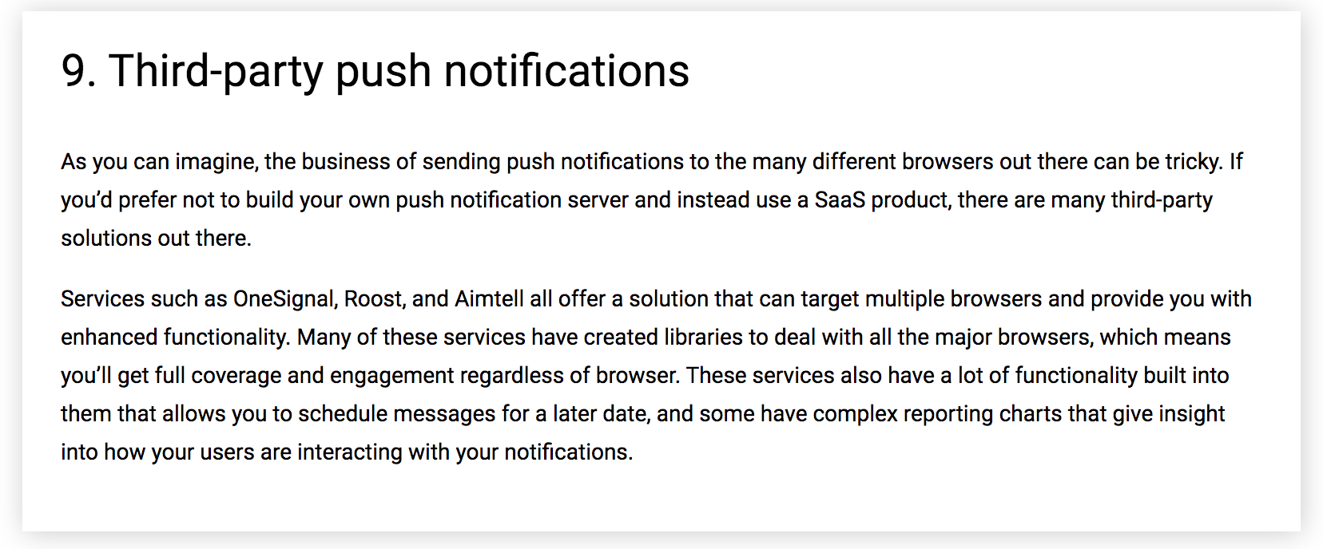

Slide 38
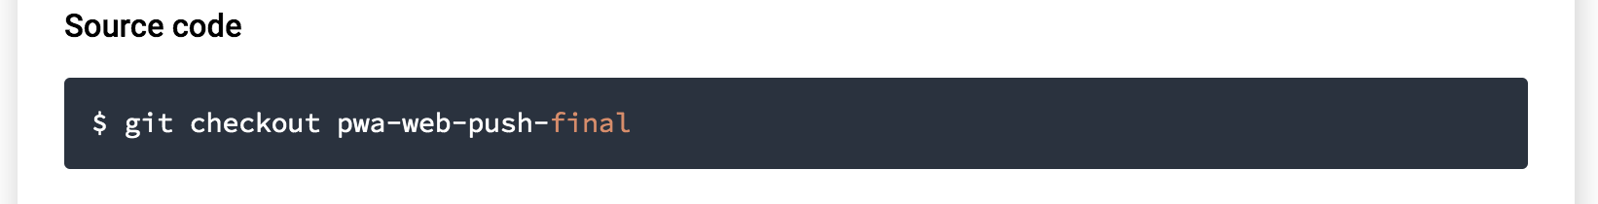
Solution

